Slide 1
Analysis of Algorithms
(CSE212)
Module 2
Brute Force

Slide 2
Module 2-Content
1. Introduction To Brute Force
2. Selection Sort
Procedure, Example, Algorithm and Efficiency
3. Sequential Search
Procedure, Example, Algorithm and Efficiency
4. Brute Force String Matching Algorithm
Procedure, Example, Algorithm and Efficiency
5. Brute Force Strengths and weaknesses
6. Brute Force Exhaustive Search- Travelling Salesperson Problem –Procedure, Example, Efficiency
7. Brute Force Exhaustive Search
Knapsack Problem - Procedure, Example, Efficiency

Slide 3
1. Introduction-Brute Force
A straight forward approach, usually based directly on the problem’s statement and definitions of the concepts involved
Examples:
Computing a^{n} (a > 0, n a nonnegative integer)
Computing n!
Multiplying two matrices
Searching for a key of a given value in a list

Slide 4
2. Selection Sort (Uses Brute Force Technique)
2.1 Selection Sort Procedure:
Scan the array to find its smallest element and swap it with the first element. Then, starting with the second element, scan the elements to the right of it to find the smallest among them and swap it with the second elements. Generally, on pass i (0 ≤ i ≤ n-2), find the smallest element in A[i..n-1] and swap it with A[i]
A[0] ≤ . . . ≤ A[i-1] | A[i], . . . , A[min], . . , A[n-1] in their final positions

Slide 5
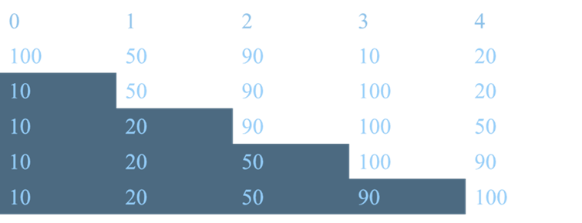
2.2 Selection Sort Example
Example:
Given array of 5 elements
Find Min of 5 elements and swap with 0th position element of array
(i.e., 10 and 100, Pos 3 with 0)
Find Min of remaining 4 elements and swap with 1st position element of array
(i.e., 50 and 20, Pos 4 with 1)
Find Min of remaining 3 elements and swap with 2nd position elements of array
(i.e., 90 and 50, Pos 4 with 2)
Find Min of remaining 2 elements and swap with 3rd position element of array
(i.e., 90 and 100, Pos 4 with 3)

Slide 6
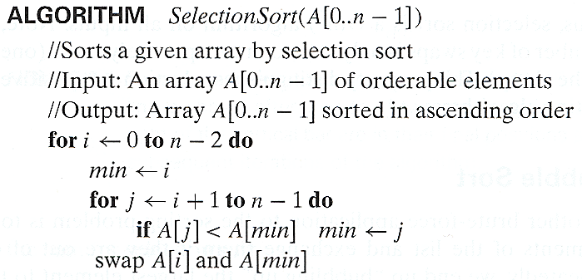
2.3 Selection Sort Algorithm and Efficiency
Efficiency
Basic operation is if(A[j]<a[min]) statement.
Basic operation is executed for n-1 times in 1st iteration, n-2 times in 2nd iteration and so on.
So basic operation is executed for (n-1)+(n-2)+(n-3)+…..2+1 units. This expression is arithmetic series Therefore efficiency is n(n-1)/2. By considering higher order variable of n, efficiency is Θ(n^2)

Slide 7
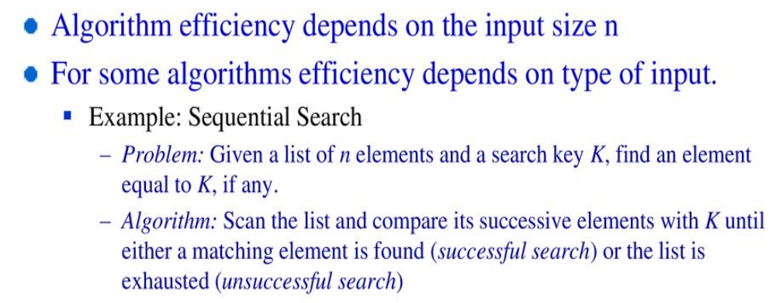
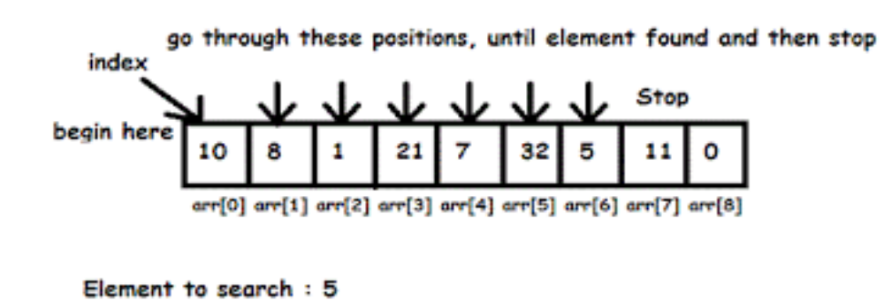
3. Sequential Search (Uses Brute Force Technique)
Example

Slide 8
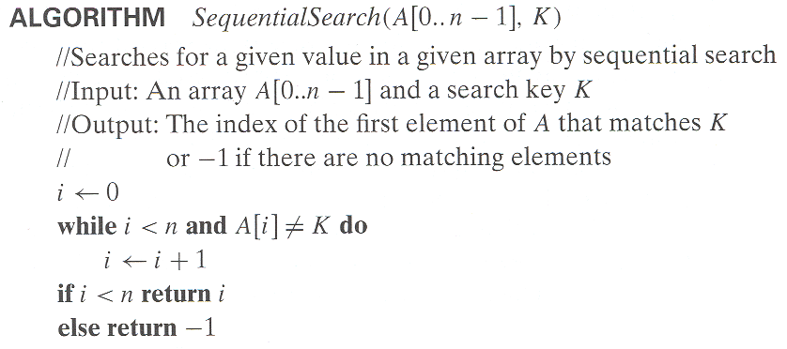
3.1 Sequential Search Algorithm and Efficiency
Efficiency:
Worst case : n key comparisons. O(n)
Best case : 1 key comparison. Ω(1)
Average case: (n+1)/2, key comparisions. Θ(n/2)
(assuming Search is successful)

Slide 9
Average time Complexity for Sequential search
Let p- Probability of getting successful search
n-No. of elements
The 1st match of element will occur at ith position. Hence probability of occurring 1st match is p/n for evevry ith element.
Probability of getting unsuccessful search is (1-p)
T(n)avg=Probability of successful+Probability of unsuccessful
=(1*p/n+2*p/n+3*p/n+….+n*p/n)+n(1-p)
=p/n(1+2+3…..+n)+n(1-p) if p=0, no successful search
= p/n*[n(n+1)/2]+n(1-p) t(n)=n
= p(n+1)/2+n(1-p) if p=1, successful search
t(n)=(n+1)/2=n/2

Slide 10
4. Brute-Force String Matching- Concept
Given a text string of n characters and a pattern of m characters. Brute Force String Matching is to search substring in the text that matches the pattern
Example Problem:
Text : I_Like_Programming ( n Characters)
Pattern : Program ( m Characters)
Solution:
Given Pattern is present in (7+1)th Position of the text

Slide 11
4.1 Brute Force String Matching
-Procedure
Brute-force string matching procedure
Step 1 Align pattern at beginning of text
Step 2 Moving from left to right, compare each character of pattern to the corresponding character in text until
    all characters are found to match (successful search) or
    a mismatch is detected
Step 3 While pattern is not found and the text is not yet exhausted, realign pattern one position to the right and repeat Step 2

Slide 12
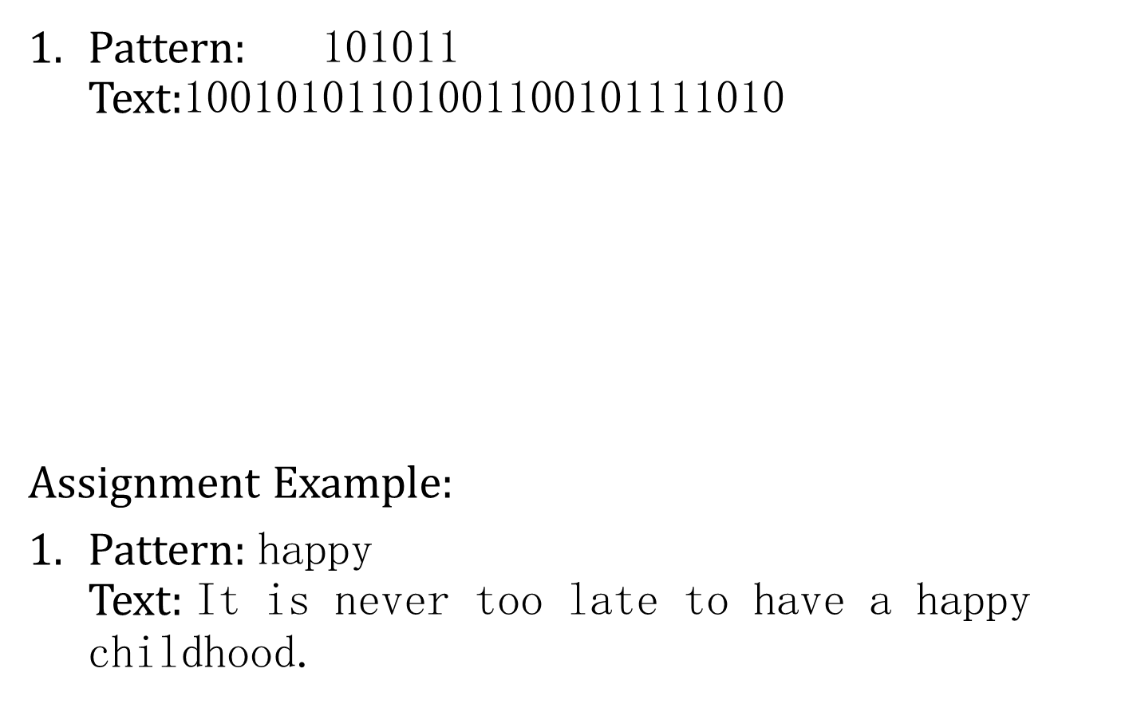
4.2 Brute-Force String Matching- Examples
10010101101001100101111010
101011 (no match, shift pattern right by 1 position)
101011 (no match, shift pattern right by 1 position)
101011 (no match, shift pattern right by 1 position)
101011 (Match Found, Return the matching position in the text)

Slide 13
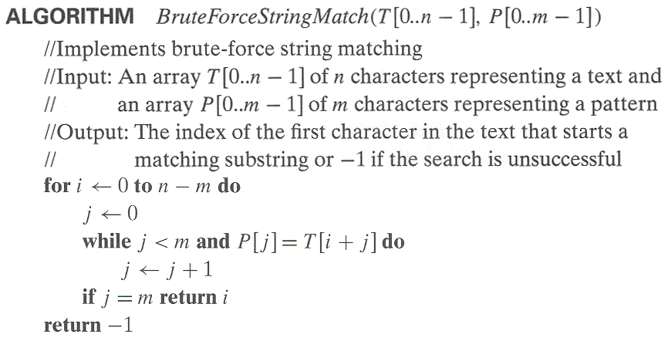
4.3 Brute Force String Matching
-Algorithm

Slide 14
4.4.1 Brute Force String Matching- Efficiency
Best Case Analysis:
The Best Case efficiency is when the pattern string to be searched is parent in the beginning of text string.
If m is the length of the pattern string. Number of comparisons required is m. So the best case time complexity is given by Ω(m)

Slide 15
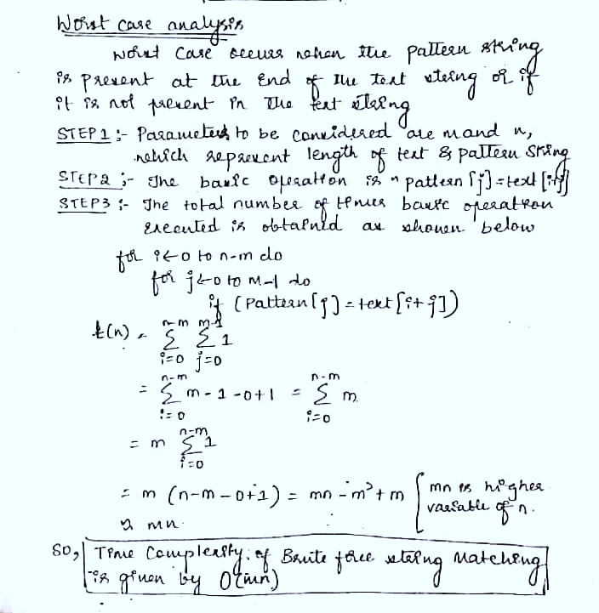
4.4.2 Brute Force String Matching- Efficiency
Worst Case Analysis

Slide 16
5. Brute-Force Strengths and Weaknesses
Strengths
  wide applicability
  simplicity
  yields reasonable algorithms for some important problems
  (e.g., matrix multiplication, sorting, searching, string matching)
Weaknesses
  rarely yields efficient algorithms
  some brute-force algorithms are unacceptably slow
  not as constructive as some other design techniques

Slide 17
6. Exhaustive Search(Uses Brute force)
Exhaustive search is a brute-force approach to solve combinatorial problems. It suggests generating each and every element of the problem domain, selecting those of them that satisfy all the constraints, and then finding a desired element
Exhaustive Search Procedure:
  Generates a list of all potential solutions to the problem in a systematic manner.
  Evaluate potential solutions one by one, disqualifying infeasible ones and, for an optimization problem, keeping track of the best one found so far

Slide 18
6.1 Exhaustive Search :
Traveling Salesman Problem
Given n cities with known distances between each pair, find the shortest tour that passes through all the cities exactly once before returning to the starting city.
TSP problem can be stated as the problem of finding the shortest Hamiltonian circuit of the weighted connected graph.
Hamiltonian circuit can also be defined as a sequence of n + 1 adjacent vertices vi0 , vi1,...,vin−1 , vi0 , where the first vertex of the sequence is the same as the last one and all the other n − 1 vertices are distinct

Slide 19
6.2 Solution and Efficiency of
TSP by Exhaustive Search
2
Tour Cost
a→b→c→d→a 2+3+7+5 = 17
a→b→d→c→a 2+4+7+8 = 21
a→c→b→d→a 8+3+4+5 = 20
a→c→d→b→a 8+7+4+2 = 21
a→d→b→c→a 5+4+3+8 = 20
a→d→c→b→a 5+7+3+2 = 17
Solution: Paths with shortest tour Cost. i.e., a→b→c→d→a and a→d→c→b→a
with cost: 17
a
b
5
3
8
4
c
d
7
Efficiency of TSP using Brute Force Θ((n-1)!)

Slide 20
7. Knapsack Problem(Uses Exhaustive Search)
Given n items: weights: w₁ w₂ … w_{n} values: v₁ v₂ … v_{n} a knapsack of capacity W .Find most valuable subset of the items that fit into the knapsack
Exhaustive Search approach Procedure:
Generate all the subsets of the set of n items given, computing the total weight of each subset in order to identify feasible subsets (i.e., the ones with the total weight not exceeding the knapsack capacity), and finding a subset of the largest value among them.

Slide 21
7.1 Solution and Efficiency of Knapsack Problem
Subset Total wt Total value
{1} 2 $20
{2} 5 $30
{3} 10 $50
{4} 5 $10
{1,2} 7 $50
{1,3} 12 $70
{1,4} 7 $30
{2,3} 15 $80
{2,4} 10 $40
{3,4} 15 $60
{1,2,3} 17 not feasible
{1,2,4} 12 $60
{1,3,4} 17 not feasible
{2,3,4} 20 not feasible
{1,2,3,4} 22 not feasible
Solution: Subset With the largest Total_Value
i.e., {2,3} with 80
Example:
Knapsack capacity W=16
item weight value
2 $20
5 $30
10 $50
5 $10
Efficiency : Θ(2^n)

Slide 22
7.2. Final Comments on Exhaustive Search
Exhaustive-search algorithms run in a realistic amount of time only on very small instances
In some cases, there are much better alternatives!
  Euler circuits
  shortest paths
  minimum spanning tree
  assignment problem
In many cases, exhaustive search or its variation is the only known way to get exact solution

Slide 23
There is no algorithm for creativity.
-Andy Hargreaves
Thank You

